Slide 1

How my data science skills and experience aid BGS’s environmental research
Rajat Choudhary
20 October 2023

Slide 2
TABLE OF CONTENTS
Demonstrating Data Proficiency: Relevant Datasets.
Relevant, Transferable Skills Acquired from past roles.
Environment Impact Through Data Science : An Example Project.
Overview
Data-Preprocessing
Modelling
Findings & Implications

Slide 3
Demonstrating Data Proficiency: Relevant Datasets

Slide 4
Overview
Spatial Data:
Transport alert system exploiting Twitter data
Geographical Bias
Explicit and Implicit feedback data
Household panel data: Survey data of 42,000 Indian households; impact of land policy on crop diversity.
Environment Data: Daily environmental conditions in the regions of Northern and Southern California, USA; wild-fire prevention.
Geochemistry and health in the Kenyan Rift Valley (BGS) : Survey data relating to land use, crops grown, drinking water source/usage drinking water, urine sample, etc.

Slide 5
Relevant, Transferable Skills Acquired from past roles

Slide 6
Overview
Conducting Extensive Literature Survey : Finding Aims, Methodology and goals of the study
Identifying Datasets, Cleaning, Exploratory Data Analysis (EDA), Data Preprocessing, Statistical and Predictive Modelling, Data Visualisation
Performing scientific research and computation
Inferring Causal Structure from the Data : Causal Discovery Analysis (CDA)
Combining a range of data sources to produce the selection rate of different features and their similarities.
Maintaining technical and Research documentation for each process : Repeatable Research
Translating findings for non-technical audiences
Combined Research with International Audience
Working in tandem with Data Management teams
Languages and Software: Python, SQL, Jupyter Notebook, Tableau, Google Colab, Spyder

Slide 7
Environment Impact Through Data Science : An Example Project

Slide 8

Overview
Aim: Predict the probability of wildfire in California and Analyze the Factors contributing to Risk Environment
Data Description: Data of daily environmental conditions from each county; spanning two years. (2018-2020)
Variables: Evapotranspiration, Precipitation, Solar radiation, Vapor Pressure, Air temp, Relative Humidity, Dew point temperature, Wind Speed, Wind Run, Soil Temp
Expected outcomes:
Which region and month are most reactive to fire?
How were the conditions in that month and regions relative to others ?
How do different environment conditions change when there is fire?
Variables with highest causality to fire?
Which combination of environment conditions result in most fire?
How similar are the regions based on their environmental conditions?
EDA
CDA
Model results

Slide 9

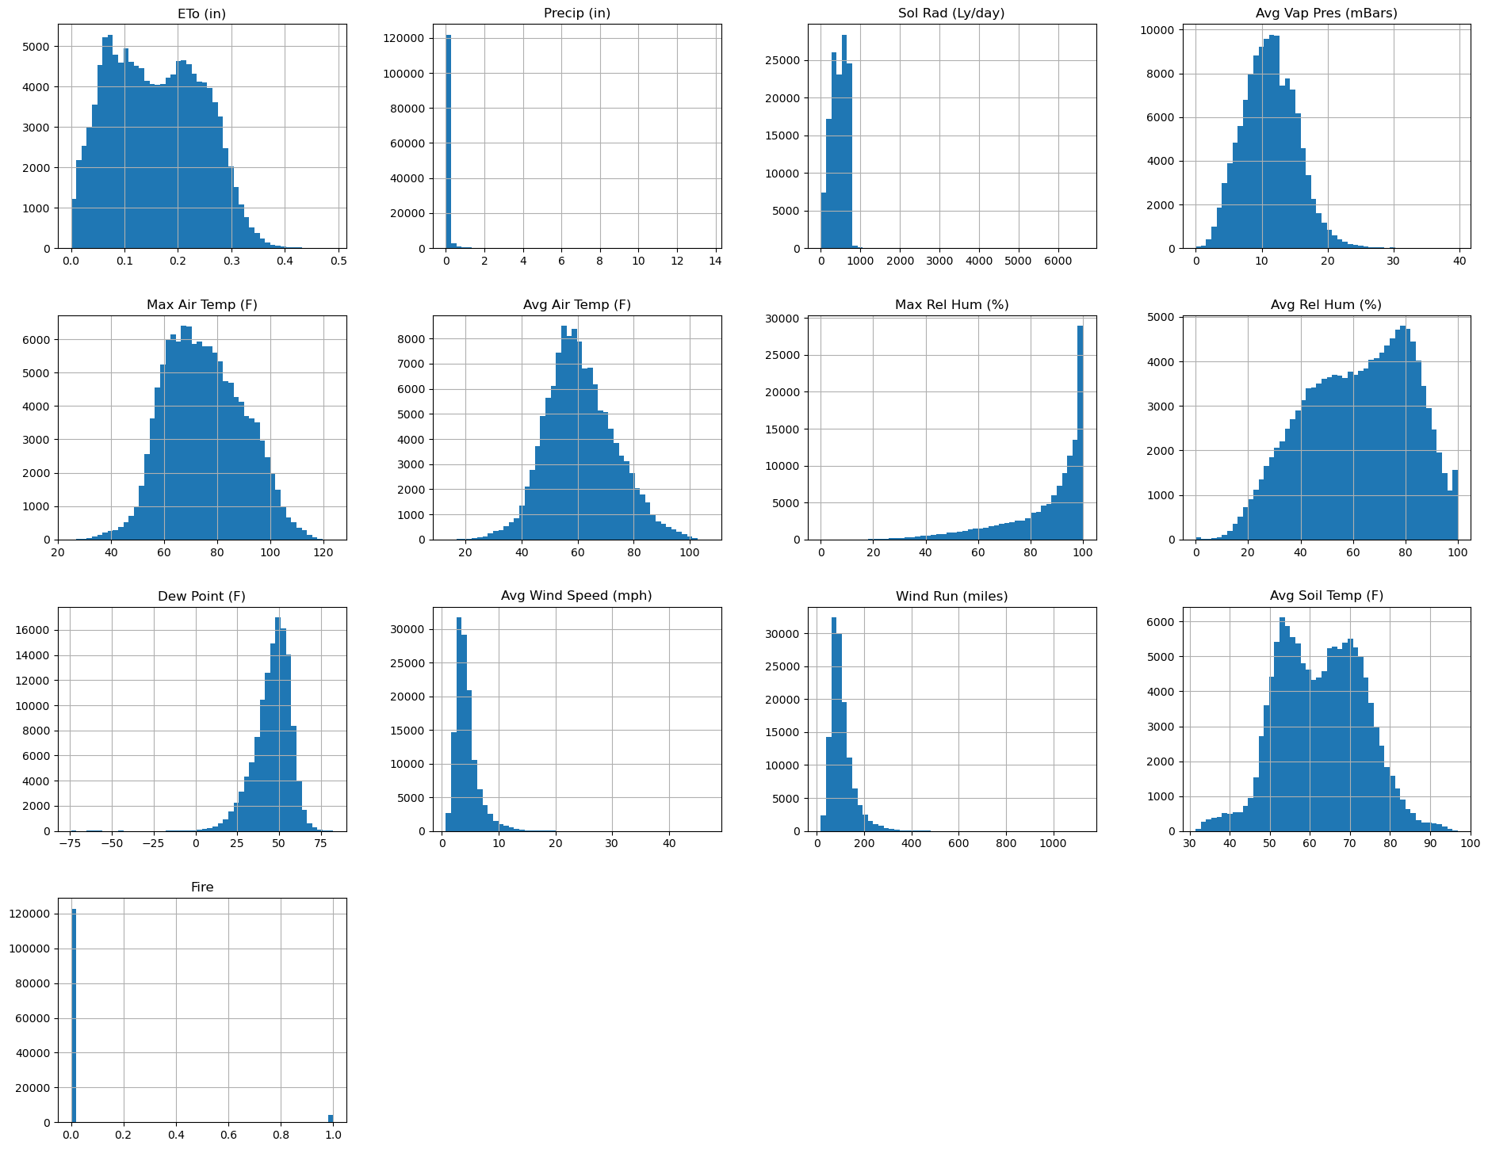
Data Preprocessing
Data Cleaning: Date Conversion, Checking for Duplicates, Feature Removal, Missing Value Imputation
Statistical Analysis:
Outlier Detection
Class Imbalance
Min-Max normalisation
Stratified Undersampling (65:35) and class weights
Train Test Split
75 : 25

Slide 10

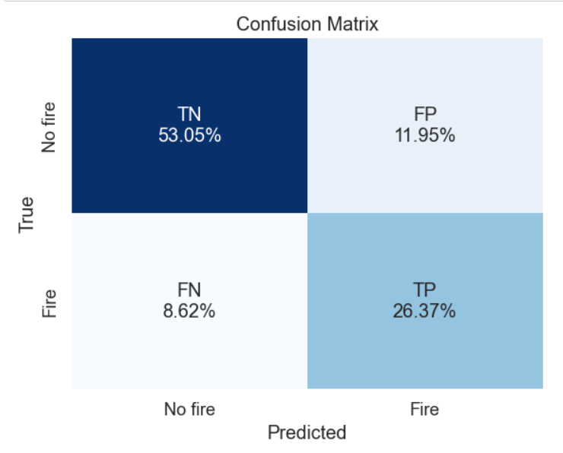
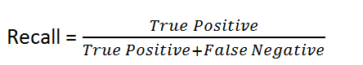
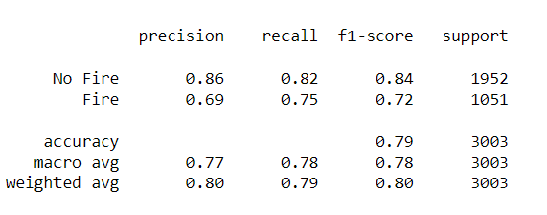
Model and Evaluation
Model : XGBOOST
Evaluation Metric: Recall
Classification Report

Slide 11
Findings

Slide 12
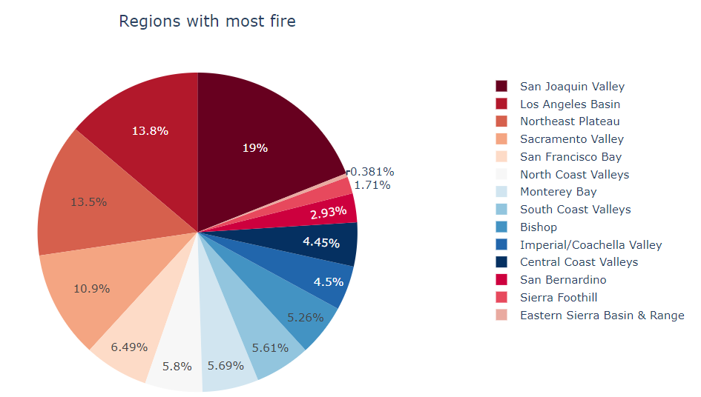
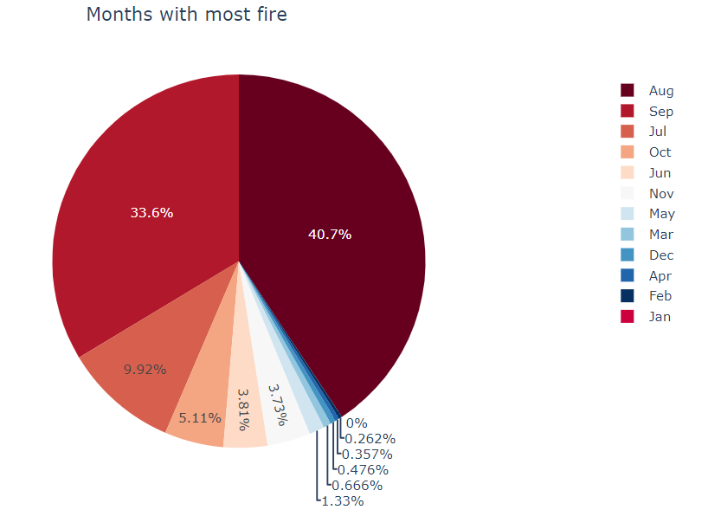
Which regions and months are most reactive to fire?

Slide 13
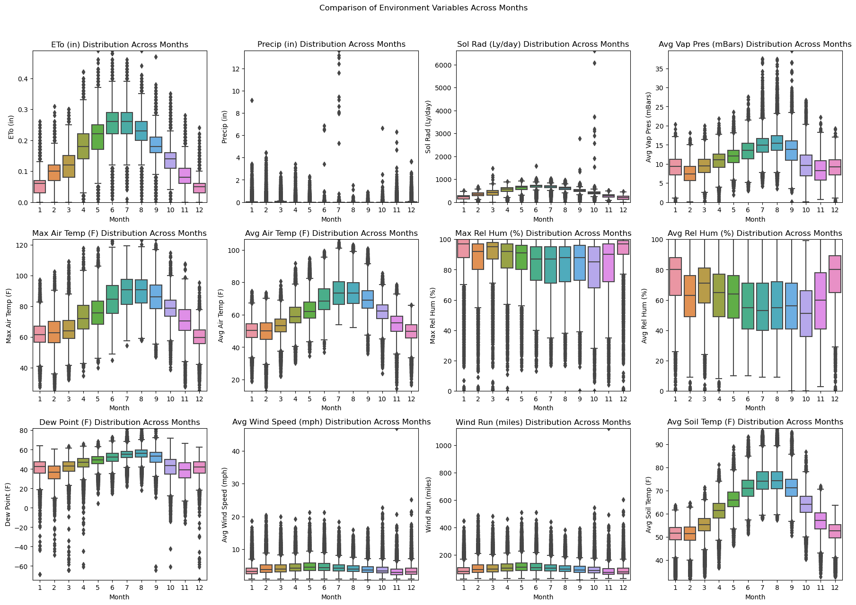
2. How were the conditions in that month and regions relative to others ?
Evapotranspiration fluctuates a lot in the months of Aug and Sept.
These months see very less precipitation, have maximum average vapour pressure.
Air temperature and Avg Soil temperature is higher.

Slide 14
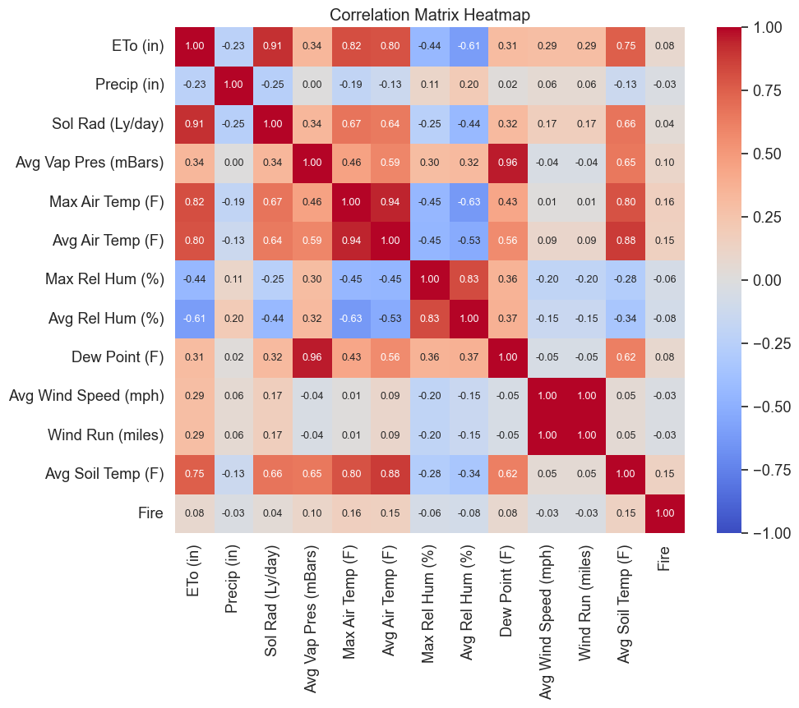
3. How do different environment conditions change when there is fire?
Positive Correlation with fire: Air Temp (Max and Avg), Avg. Soil Temp, Avg. Vapor Pressure, Dew point, Evapotranspiration, Solar radiation
Negative Correlation with fire: Relative humidity (Max and Avg), Avg. Wind Speed, Wind Run, Precipitation

Slide 15
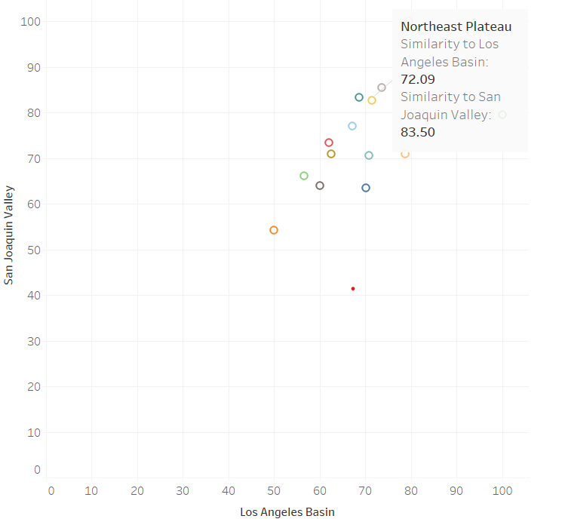
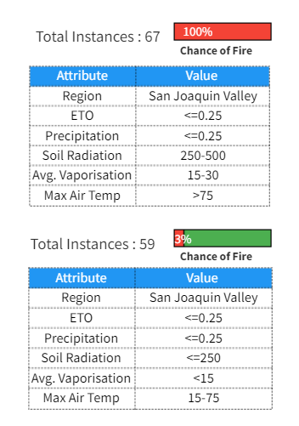
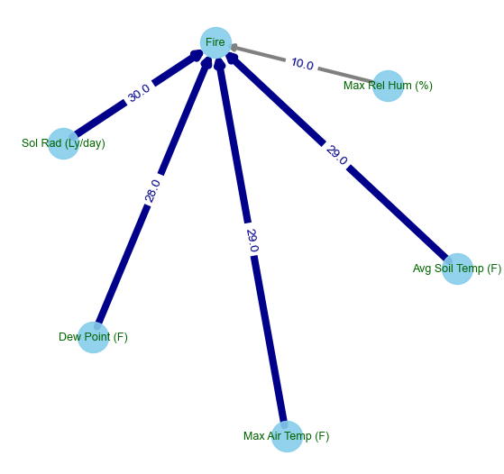
4. Variables with highest causality to fire?
Model : Structural Agnostic Model(SAM)
5. Which combination of environment conditions result in most fire?
6. How similar are the different regions based on their environmental conditions?

Slide 16
Thank you ☺

